Slide 1
Wireless Mesh Networks
Myungchul Kim
mck@kaist.ac.kr

Slide 2
Mesh Networks: Commodity Multihop Ad Hoc Networks
R. Bruno, M. Conti and E. Gregori, IEEE Communications Magazine, pp. 123 – 131, March 2005
Mobile (multihop) ad hoc networks (MANETs)
  Self-organization, no preexisting communication infrastructure
  For over 30 years – packet radio network (1972)
  For tactical networks: cost is not a main issue
  Recently, low-cost wireless technologies (Bluetooth and IEEE 802.11) and IETF MANET working group
  “the network is made of users devices only and no infrastructure exists” -> move to “opportunistic ad hoc networking”
  Mesh networks

Slide 3
Mesh networks
  Inherit many results from MANET research but have civilian applications as the main target
  Simulation (for ad hoc networks) vs real testbeds (for mesh networks)
  Off-the-shelf and proprietary applications
  Off-the-shelf: community networks built on 802.11, Seattle, San Francisco, Roofnet system at MIT, …
  IEEE 802.11s, 802.15.5, 802.16a, 802.20

Slide 4
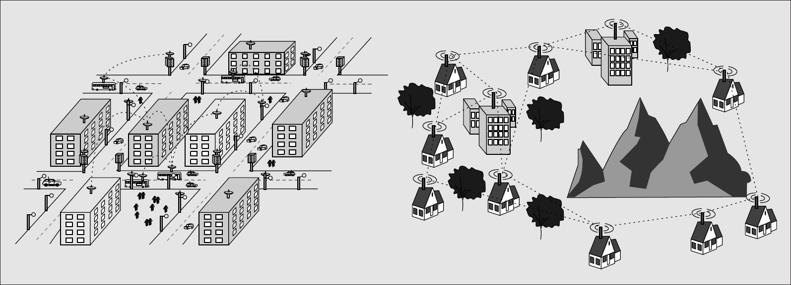
Popular commercial applications for WMN
Intelligent transportation systems
  Providing real-time travel information to passengers
  300 buses in Portsmouth
  Bus schedule, destination, arriving time
  Address transportation congestion problems, control pollution and improve transportation safety and security
  Fig 1

Slide 5
Popular commercial applications for WMN
Public safety
  9/11
  How about cellular technologies?
  Answer: data rate is limited and the network infra is extremely costly.
  The police department in the San Francisco, employing 802.11 b/g for communications
Public Internet Access
  Without the need for extremely costly wired network infra
  Some access points are directly connected to a wired backhaul network

Slide 6
System and network architectures for WMNs
WMN
  A fully wireless networks that employs multihop communications to forward traffic en route to and from wired Internet entry points
  A hierarchy in the network architecture (e.g., wireless routers, wireless backbone, mobile users) different from flat ad hoc networks
  Highly scalable and cost effective
  Easy deployment of high-speed ubiquitous wireless Internet
  Fig 2

Slide 7
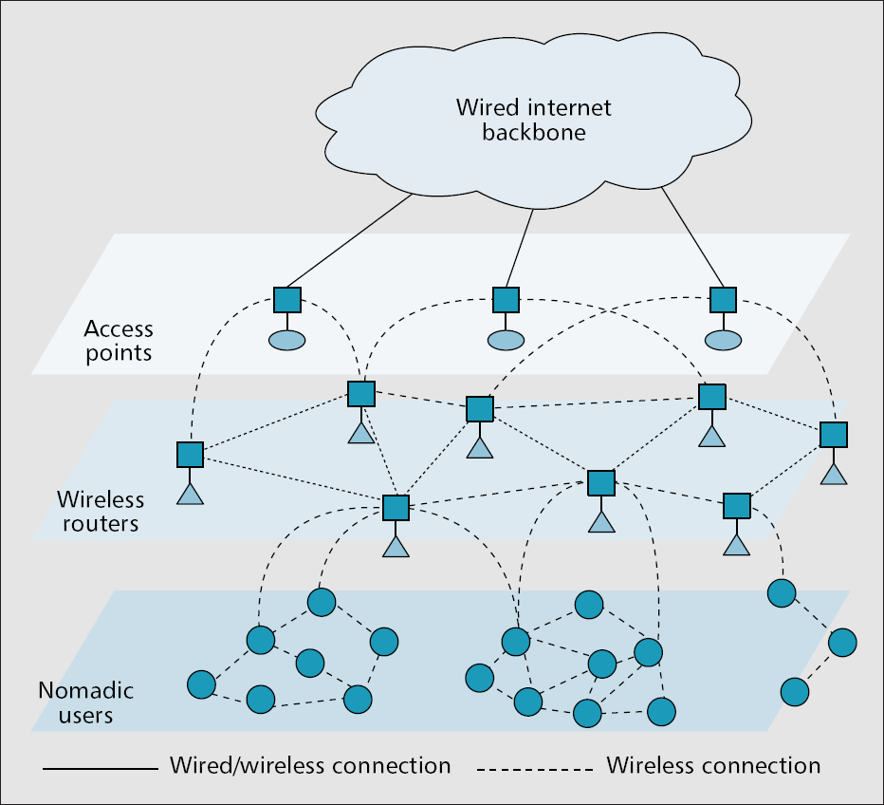

Slide 8
System and network architectures for WMNs
Reduction of installation costs
  WiFi hot spots: the downside of this solution is an unacceptable increase in the infra costs because a cabled connection to the wired backbone is needed for every access points
Large-scale deployment
  High data rate of IEEE 802.11 a/g -> shorter distance (picocellularization of WLANs)
  Multihop communications offers long distance communications via hopping through intermediate nodes
  The wireless backbone can realize a high degree of spatial reuse and wireless links covering longer distance at higher speed than conventional WLAN technologies.
Reliability
  Multiple possible destinations
Self-management
  Self-configuration and self-healingness

Slide 9
Off-the-shelf solutions for building mesh networks
  Community networks: provide shared cost-effective broadband Internet access to a neighborhood
  Nonproprietary off-the-shelf technolgies
Roofnet
  802.11b mesh network
  50 houses
  MIT
  Ominidirectional antennas to reduce the per-node costs
  Only the gateways with directional antennas
  Multihop routing protocol
  Rootnet node acts as a router

Slide 10
Proprietary solutions for building mesh networks
  Incompatible
  IEEE 802.11 technologies on ISM(industrial, scientific, and medical) unlicensed band (2.4 GHz) or a proprietary radio platform
  Its own wireless routing protocol or AODV

Slide 11
Open standards implementing WMN techniques
  Wireless personal area networks (WPAN), WLAN and wireless metropolitan area networks (WMAN)
IEEE 802.15.5
  Short-range wireless connectivity for small of groups of fixed, portable, and moving computing devices
  WPAN
  Power limitations of mobile devices
  Ultra wideband (UWB): using shorter links significantly increases the throughput
  A cluster-based network architecture, where devices are grouped in small piconets.

Slide 12
Open standards implementing WMN techniques
IEEE 802.11s
  Providing the functionality of an extended service set (ESS) mesh
IEEE 802.16A
  WiMAX
  Point-to-multipoint (PMP)
  Reliable non-line-of-sight (NLOS)
  Mobility
IEEE 802.20
  Mobile broadband in a cellular architecture (e.g., macro/micro/picocells)
  802.16: 2-6 GHz
  802.20: below 3.5GHz, high-speed mobility issues (up to 250Km/h)

Slide 13
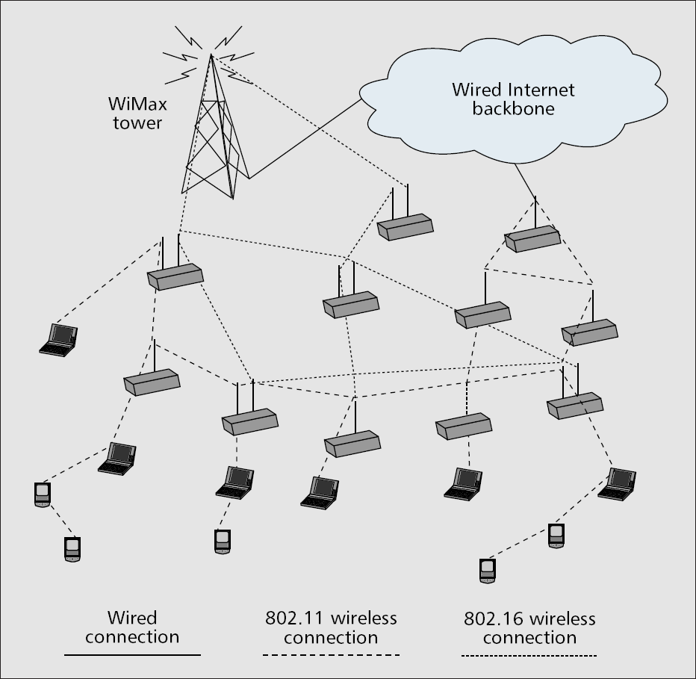
Open standards implementing WMN techniques
  Fig 3

Slide 14
Key research challenges
  Well-known scalability limits of ad hoc networks due to the dramatic degradation of througput and delay performance as the network diameter increases [5]
High-capacity and reliable radio interfaces for the wireless backbone
  Multiple radio interfaces, multiple-input multiple-output (MIMO) techniques, beamforming antennas and opportunistic channel selection
  Diversity techniques make the channel less fading
  Smart antennas or adpative array processing to copy with inteference

Slide 15
Key research challenges
Designing scalable and opportunistic networking functions
  Random MAC protocols suffer from increased contention in the network
  Several paths at the same time to reach a given access point
  Cross-layer design: spatial diversity and frequency diversity
  The design of scheduling policies for a multichannel, multihop, and multidestination system is extremely challenging because ?
  Routing metrics
  How about proactive routing such as OSPF?

Slide 16
Key research challenges
System-wide resource management
  Aimed at eliminating the spatial bias by ensuring that each user receives the same fair share of resources independent of how far it is from the Internet entry point
  Exploit spatial reuse in the wireless backbone
  System-wide notion of fairness

